Slide 1
Video Classification using TimeSformer- (Meta AI)

Slide 2
Understanding the Problem
Former Video Classification Approaches
3D Convolution: 3D patterns formed by stacking sequences of 2D frames.
Transformers (Replacing CNN architecture)
Shortcomings of the above approaches:
Not suitable for lengthy videos
High Convolutions(Bias)
High Computational complexity and Training time

Slide 3
Cont..
TimeSformer: (Time Space Transformer )
Concept of attention mechanism from sequence models to capture patterns in both space and time.
Uses Temporal and Spatial Analysis
How is it better compared to previous approaches:
Higher Classification accuracy
Less training and computational time
Convolution free approach

Slide 4
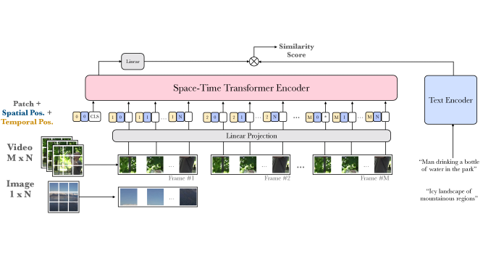
Architecture
Compared to the traditional Transformers architecture, TimeSformer:
Enables spatiotemporal feature learning directly from a sequence of frame level patches.
Positional Embedding is carried in 3 phases. With no Embedding, using Space only and using both Space and time

Slide 5
Techniques
Normalization
Divided Space time attention
Feedforward attention
Positional Embedding
Regularization

Slide 6
Conclusion
The Dataset UCF11(Action recognition dataset) has been used for this model and the following results have been observed.
Achieved Higher accuracy, 3-times less training time compared to the generic transformer's architecture.
Successfully tested on few videos with length greater than 1 Minute.
TimeSformer operates on 8*224*224 video clips.

Slide 7
What did you learn today?
TimeSformer- A new type of video classification approach which uses both space and time complexity.
How different is it from the regular Vision Transformers Architecture by using Space and time complexity.
Training longer video clips, upto several minutes long which cannot be done efficiently with regular transformers.
Also, to train more powerful TimeSformer variants like TimeSformer-HR (operating on 16-frame clips sampled at 448x448 spatial resolution), and TimeSformer-L (operating on 96-frame clips sampled at 224x224 spatial resolution) we need a GPU with more than 32GB of memory

